Slide 1

UNIVERSITY OF PETROLEUM & ENERGY STUDIES
School of Computer Science Dehradun
COURSE: Physical and IT Security July – December 2023
Delivered
by
Dr. Gopal Singh Rawat
1

Slide 2
Course Plan
CO1. Introduction to Physical Security CO2. Approaches to Physical Security
CO3. Standards, Regulations and Guidelines
CO4. Fire and Fire Safety Inspection CO5. Vulnerability Assessment
CO6. Security Surveys and Audit
CO7. Security Lighting, Alarms
CO8. Video, Biometrics, Access Control, Fences CO09. Security Personnel
2

Slide 3
Chapter 4. Fire and Fire Safety Inspection

Slide 4

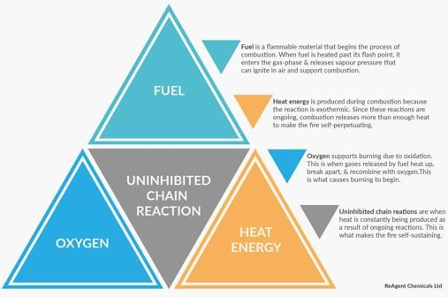
4.1 Fire and Fire Safety Inspection
Main Issues: Fire can destroy Assets and Data
Fire Suppression →Extinguishing fire, rather Preventing
Required to burn continuously
Traditional methods – remove any one component → Extinguish fire
Fire Components →
#1 Air – oxygen gas for combustion
#2 Fuel – inflammable substance
#3 Heat – causes fuel to burn
New Component → #4 Chain / Chemical Reaction
Heat from on going burning process/reactions
Due to Fuel and Gas
Adds to combustion
Maintains fire
Last longer

Slide 5
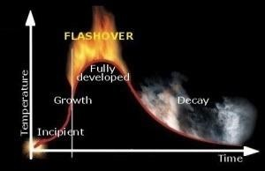
4.2 Stages of Fire
Ignition/Incipient
Growth
Full Developed Decay (Burnout)
4.3 Mechanism of Fire
Conduction
Direct contact between things → Spread → Wooden Table → Burning → Cloth Curtains
Convection
Transmission of heat in a fluid/gas by circulation → hot areas – cool areas → Spread
Radiation
Transfer of heat without aid of any objects
Electromagnetic waves → thru window panes and ignites inside of buildings

Slide 6
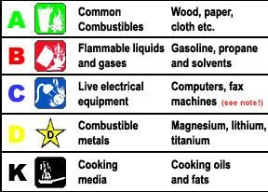
4.3 Types / Classes of Fire
4.4 Fire Safety Standard
National Building Code (NBC 2016)→ 4th part deals with fire and life safety
Safety of life > Means of exit in case of fire
Main points of the code:
Fire Prevention
Life Safety (fire, fumes, smoke, or panic)
Fire Protection

Slide 7
4.4 Fire Safety Standard: Fire Prevention
Building occupancy wise requirements
Group A – Residential
Group B – Education
Group C – Institutional
Group D – Assembly
Group E – Business*
Group F – Mercantile
Group G – Industrial
Group H – Storage
Group J – Hazardous
Group E – Business*
Sub-divisions:
E1: Office, Bank, Professional Establishments (Engineers, Police, Architects, Lawyers
E2: Labs, Research Establishments, Library, Test offices
E3: Computer Rooms – IT Server room, Data Hosting (cages)
E4: Telephone Exchanges
E5: Media – TV/Broadcasting

Slide 8
4.5 Fire Zones
Demarcation: area / city / district – locations under jurisdiction of an authority
Number/Designation of Zones: 1 (A,B,C,D,E,F) , 2(G), 3 (H,J)
Type of Construction –
Fire resistance of building in terms of hours
Fire load expressed KCal/sq. mt., Types → 1, 2, 3, 4
General requirements for all individual occupancies:
General Safety requirement
Fire Stop / Enclosure of opening
Exceptions / deviations
Electrical Installations
Building under construction phase
Air Conditioning and Ventilation
Maximum height
Smoke Vents
Mixed occupancy
Open Space

Slide 9
4.6 Life Safety
General Safety requirement
Number of Exits
Exit requirement
Doorways
Corridors / Passageways
Occupant Load
Exit Capacity
Exit Arrangements
Internal /External Staircase
Ramps
Horizontal Exits
Fire Tower
Fire Lifts
Emergency Escape / Lighting
Illumination of means of exit
Fire Detection & Warning
4.7 Fire Protection
Fire Extinguishers / Fixed Fire Fighting Equipment
Fire Detection / Extinguishing Systems
Using Halon Alternatives /automatic sprinklers

Slide 10
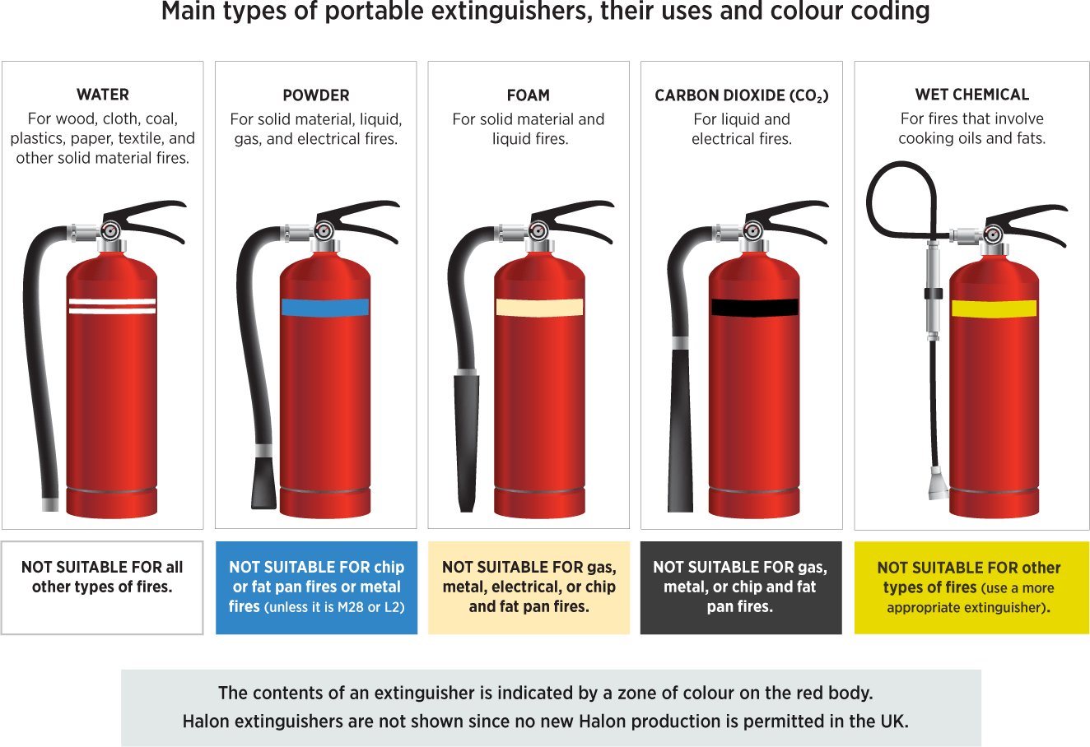
4.7 Fire Extinguisher Codes
https://mptownplan.nic.in/act%20&%20Rules/NationalBuilding%20Code%20Part-IV%20(Fire%20Safety).pdf

